Slide 1
Google Forms-The Basics

Slide 2
How to Create a Form
Enter Drive
Click on “New”
Click on “More”
Click on “Google Forms”

Slide 3
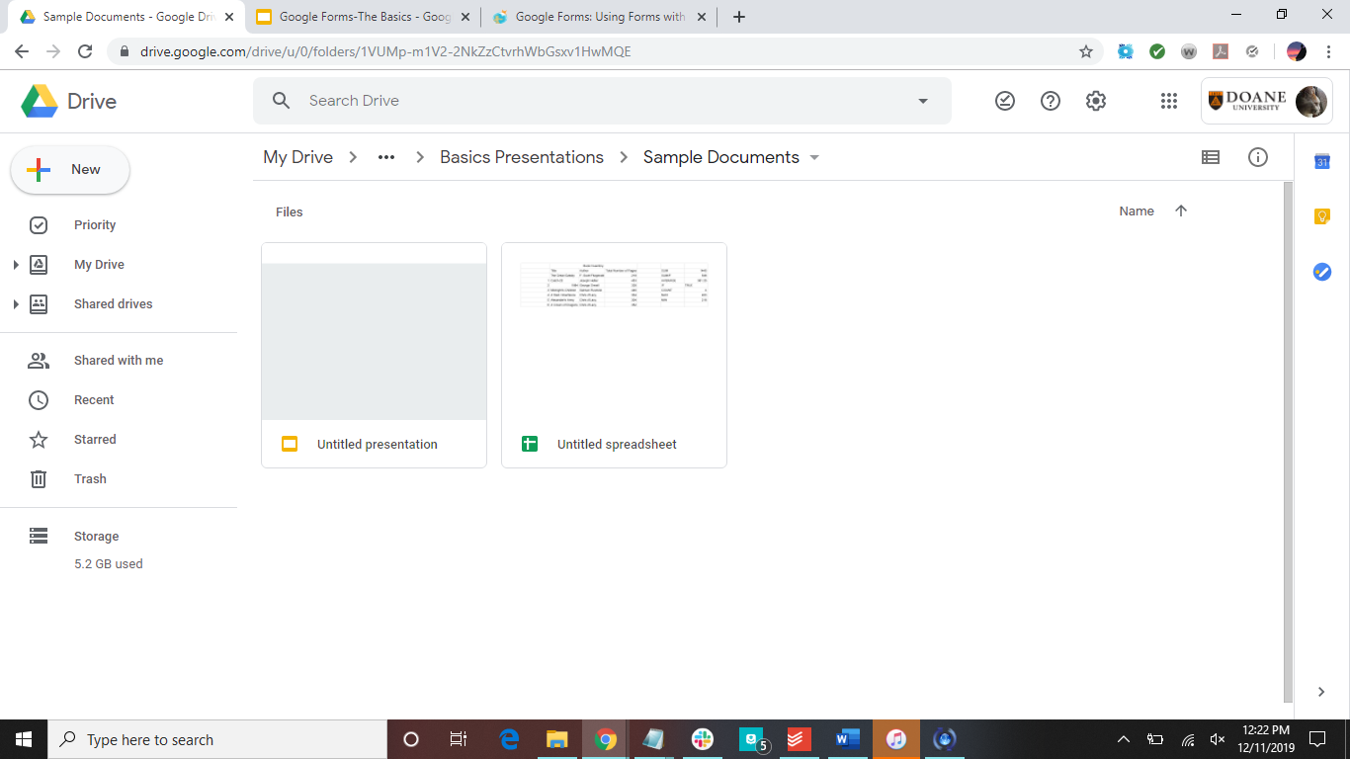

Click here

Slide 4
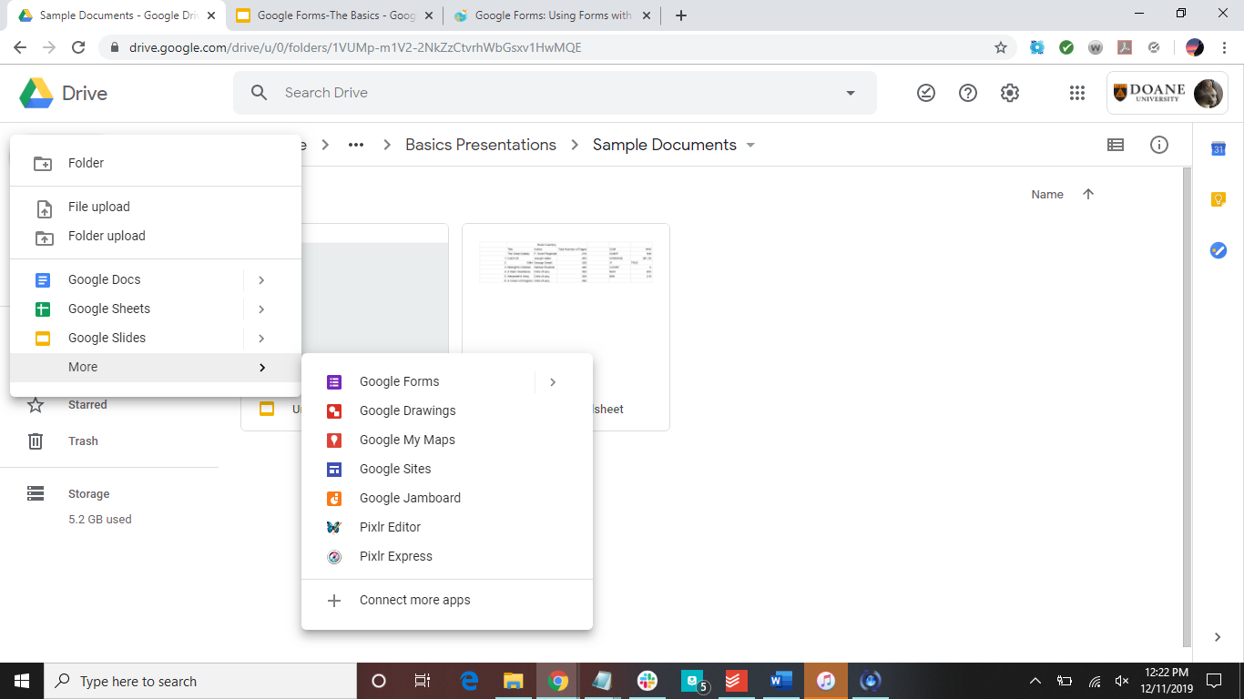

Slide 5
General Navigation
Title
Description
answers
Question type
Duplicate
Delete
Required question
Add question
Add title and description
Add image
Add video
Add section

Slide 6
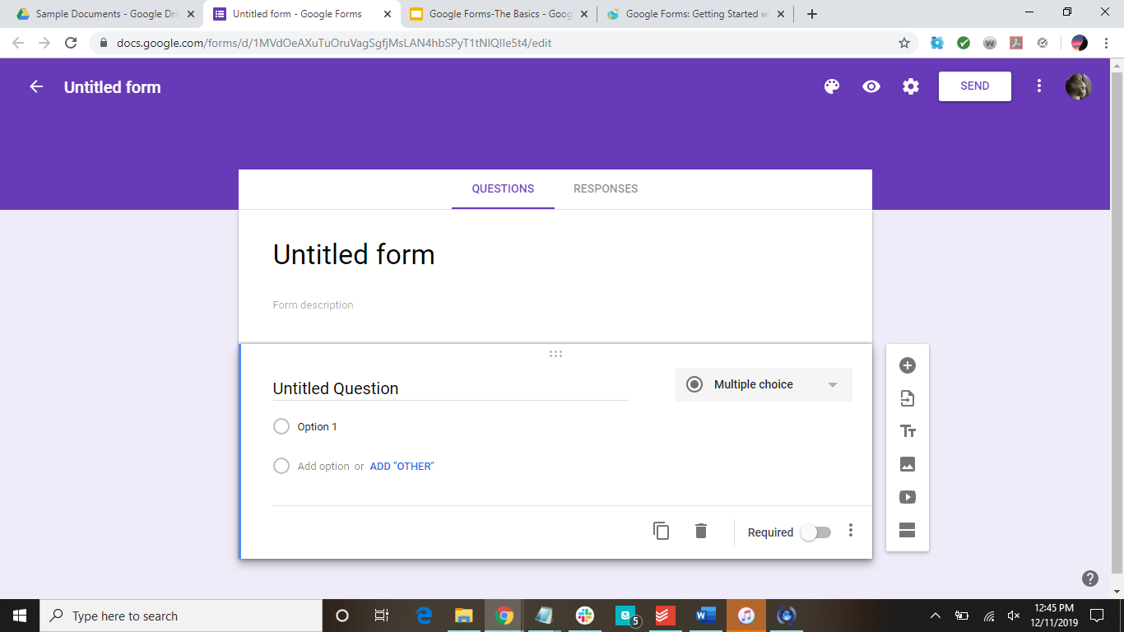

Slide 7
What Forms Can Be Used For
Can be used for many things:
Event invitations
Gather contact information
Create feedback forms
Create quizzes and worksheets for the classroom

Slide 8
How To Create Questions
Click on add question
Choose question format
This also will change depending on what you put in the question
Type in question and answers

Slide 9
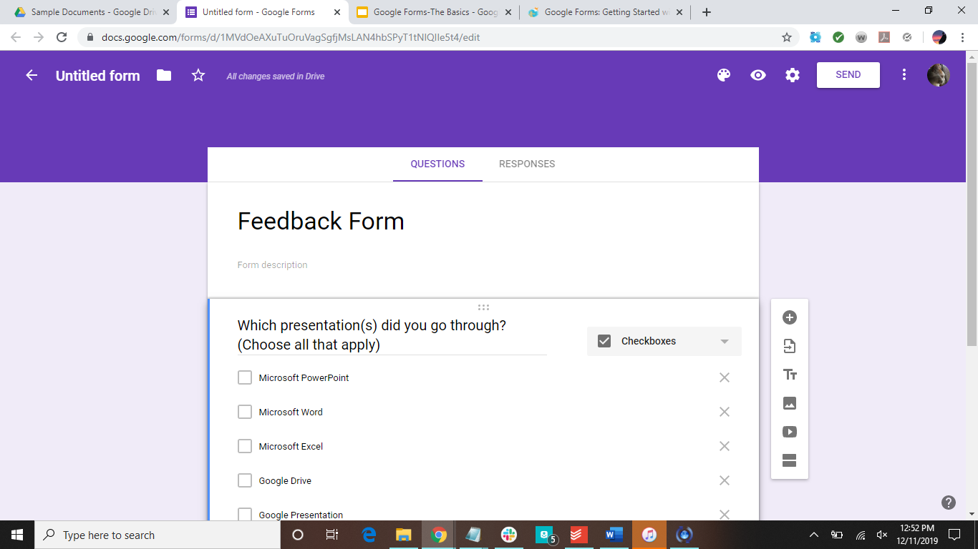

Slide 10
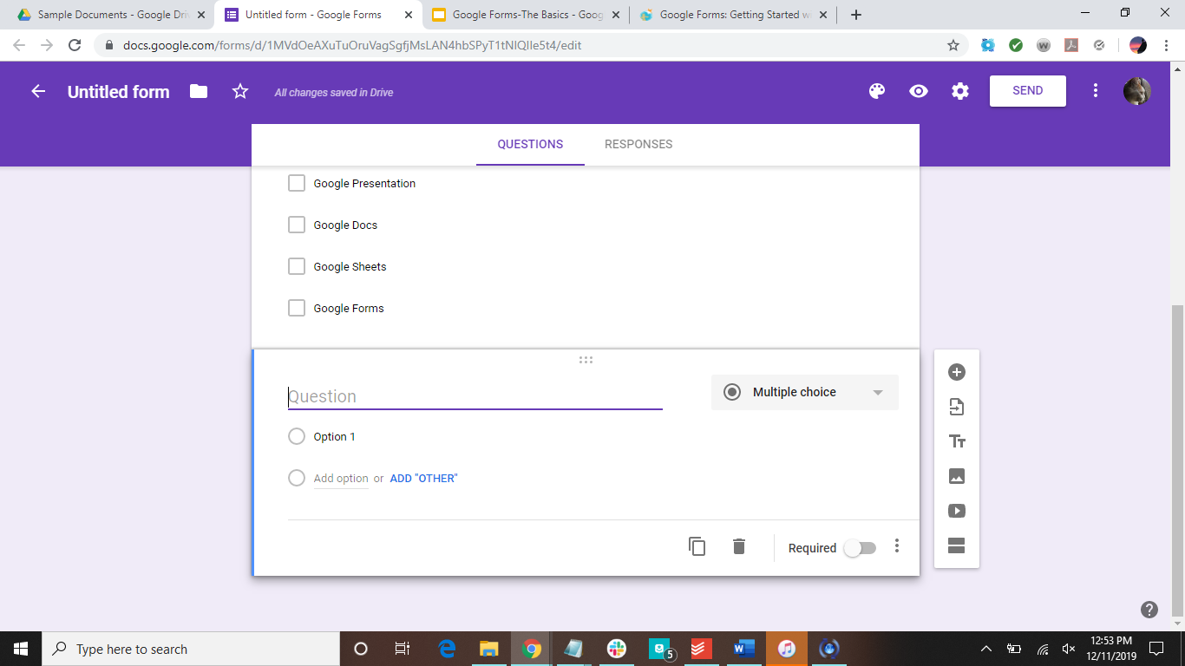

Slide 11
Types of Question
Short answer
Paragraph
Multiple choice
Checkboxes
Drop-down lists
File upload
Linear scale
Time
Date

Slide 12
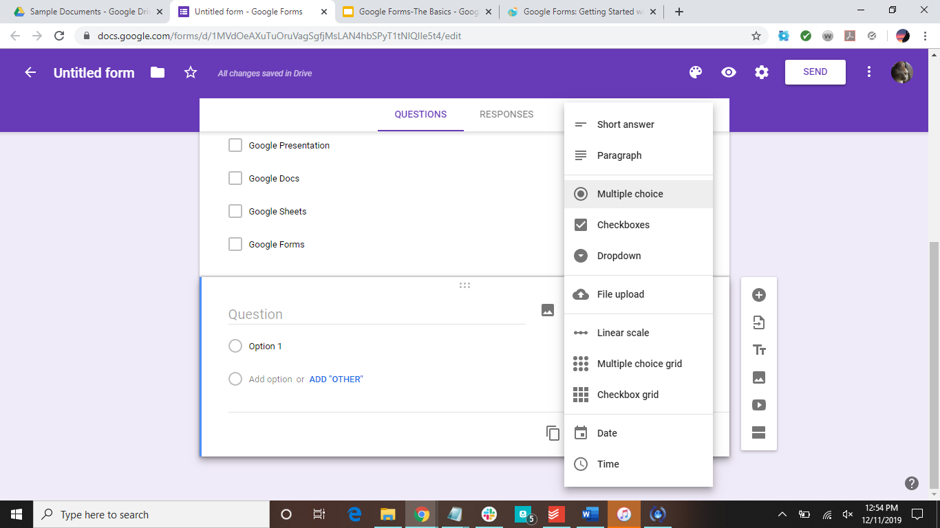

Slide 13
Where Responses Are Saved
Two places:
In the responses tab
Google Sheets document
Other things that can be done with responses:
Get email notifications for new responses
Download responses
Print all responses
Delete all responses

Slide 14
Responses tab

Slide 15
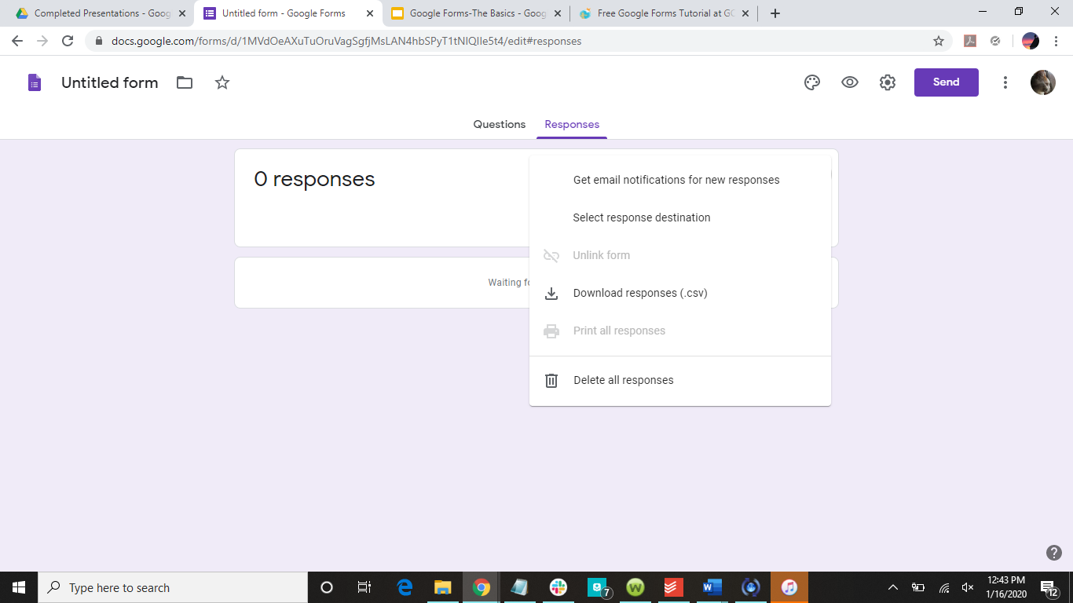

Slide 16
Settings
Change the settings to make the form fit your needs
General
Collect email addresses
Require signing in
Presentation
Show progress bar
Shuffle questions
Confirmation message
Quizzes

Slide 17
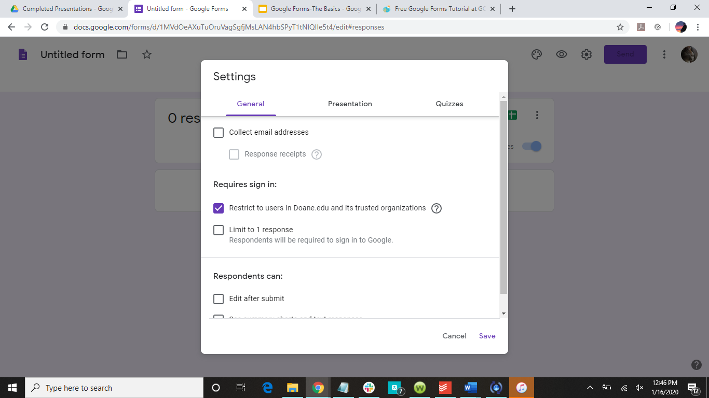

Slide 18
Sending Form for Responses
Three options:
Directly input emails to send the form to with a message
Copy a link to the form that can be added to a website, email, ect.
Get an embed code for the form

Slide 19
Directly input emails to send the form to, copy a link to the form, or get the form’s embed code

Slide 20
Analyze Responses
Google Forms will do some initial analyzing of the responses you have received
If you save the responses to a Google Sheets document, then there are other things you can do with the responses

Slide 21
Assignment
Create a simple quiz in Forms (three to five questions). Send it to me and I will take the quiz. Save the responses in a Google Sheet.

Slide 22
Have more questions?
Email us at ccla@doane.edu or come visit us in Communications 188D from 9am to 5pm.
You can also visit our website at https://www.doane.edu/ccla

Slide 23
References
GCFLearnFree.org. Google Forms. Retrieved from https://edu.gcfglobal.org/en/google-forms/

Slide 24
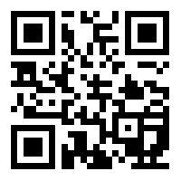
Please provide some feedback on the presentation by following the QR Code below.

